Slide 1


LIVE WEBINAR
Software
You suck at buying it….and patching it, sorry
Sumo Logic

Slide 2



Who am I?
Husband and Father
Surfer
Hydrofoiler
Brazilian Jiu Jitsu Nerd
Traveler
Builder of things
Destroyer of Code
Senior Solutions Engineer
/david-a-girvin/
Background:
Tech:
Ship Captain
Pilot
Owner of Fabrication and Engineering company
Missionary
Late change to tech
1Password
We hack Purple
Bit Discovery
Red Canary
Sumo Logic
Sumo Logic

Slide 3

APOLOGIZE AGAIN

Slide 4
Warning!
These concepts and thoughts are based on anecdotal experiences from building security programs and selling security tools. They are my personal opinions.
If you disagree that is perfectly fine.
If you need to email me to complain about my talk:
Youneedabetteruseofyourtimethantocomplainaboutmytalk@hotmail.com
If you find me abrasive and sarcastic but somewhat charming…..You are not wrong.
If you hang toilet paper over the back of the roll, please leave this talk now.

Slide 5


Slide 6
Understanding the sales Bro
You get the job by exuding confidence
You can be a winner one min and a loser the next
Its super hard in the crowded market
You get fired it you don't earn
It all start over every year
They encourage you to be in debt and like expensive shit
They don’t realize the social engineer a culture to never be satisfied
The more you buy into it the more slimy you come across to engineers
Honestly most of them are good people….I can't believe I said that…

Slide 7
Overview
We will explore the software buying process across both sides of the table. Hopefully having a better understanding of the process and how both parties can benefit.
Sales cycle
Sales peoples criteria for success
Sales peoples pay structure
Partners / resellers
Traps and pitfalls
POVs
How to be a good buyer
How to not get screwed
Sumo Logic

Slide 8
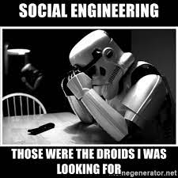

Social Engineering a Security Culture
Good Social Engineering
Bad Social Engineering
Learns what is beneficial to both parties.
Knows their audience.
Has buy in from all parties needed.
Builds a culture based on trust and visibility.
Servant Leadership
Self focused goals.
Does not benefit all parties involved.
Manipulation and zero visibility.
Using the stick instead of the carrot.
Sumo Logic

Slide 9

Architect
Pentester
Account Executive
Appsec Engineer
Sale Engineer

Slide 10
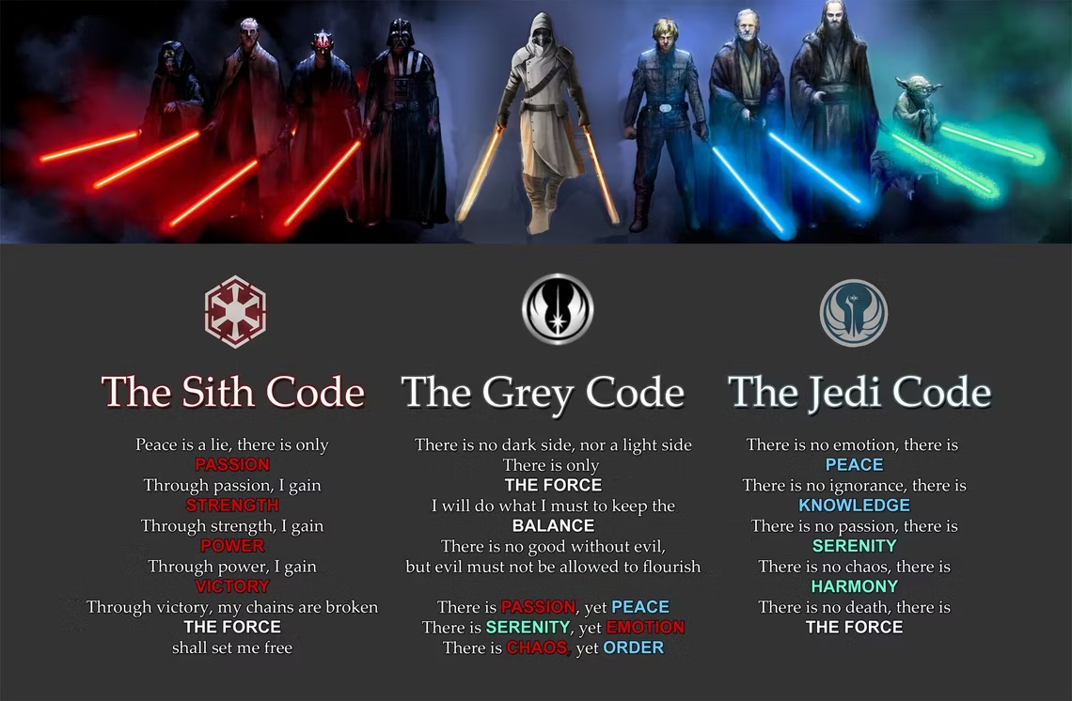

Slide 11
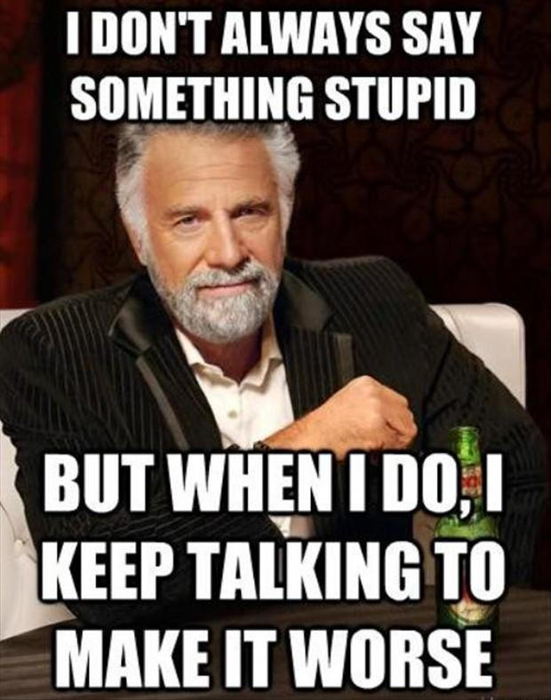
Sales Roles
Sales Development Representative
Account Executive
Sales Engineer
Regional Director
Field CTO / CISO
Actual E Suite
Lawyers
Professional Services
Sumo Logic

Slide 12
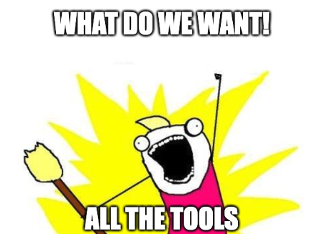
Tools!!!!
Tool acquisition is long and hard. Do it right.
Don’t trust the hype! Sales can be a sketchy.
The less tools to do your job adequately the better. Looking at 17 different things a day is the path to dark side.
Build a plan BEFORE you acquire tools. Having a centralized location for data and vulnerabilities will make achievable goals.
Spend time testing tools before purchasing anything. Document the process and create a scoring system to be pragmatic about choosing.
Test the tools API before buying. Some fancy tools have shit APIs.
OWASP has a great chart with open source and commercial tools for all controls.
When you get a tool. Implement, tune and improve before you get another tool. Take your time it is a slow process.
Old Slide
Sumo Logic

Slide 13
What is the sales cycle?
The sales cycle can always be different but this is a basic outline for enterprise and mid market.
Prospecting and research
People sending you emails and cold calling
Discovery call
Short call to see if it is a good fit
Demo
Longer call tailored to info from disco
Proof of Value
Week to multi week proof of tool
Executive alignment
Aligning with actual stakeholder
Financial and pricing
Aligning final price to submit
Legal fighting over everything
Procurement
Sumo Logic

Slide 14
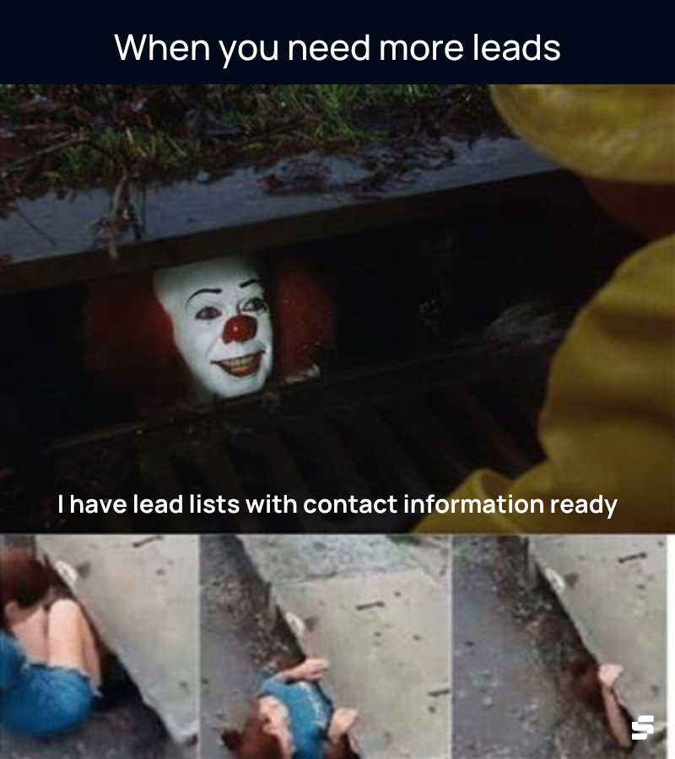
Prospecting
SDRs get paid for booking meetings with qualified companies
If they dont they get fired
Most are early 20s and don't know shit about shit in tech
You hate emails and cold calls (everyone does)
They hate it too but it’s the only way in to real sales
Everyone hates linkedin but we all have to use it
Solution
There isn't a great solution currently.
You need to hear from companies to know what's out there
The best solution I have seen is scheduled time
Get to know your AEs if you can
Delegate to people who use the tools
Sumo Logic

Slide 15

LinkedIn CISO rant
You get a budget, run a team, speak to the board etc
You usually aren’t really up to date with innovation
Your “friends” in the industry aren't either…..group think
Stop bitching about cold calls when you don't have a way to be reached professionally…..email obviously doesn't work
Good communication from the start will pay dividends here.
If we have a team to keep up with competitors innovation in the space I promise you don't know what you think you do.
All in all dont be a dick this isn't the old school security culture where people worship you. Make friends get invited to cool shit and enjoy the industry that pays us all.
Sumo Logic

Slide 16

Disco Call
Nobody wants to waste time at this level
Sales Engineers time is stretched thin
Sales is looking for pain points that match their tools benefits this sometimes leads to uncomfortable questions
Matching Technical wins to pain and business use case will be the SEs goals
AE will be finding out timeline, budget approved, actual buyer, executive and champion
SDR will be praying its a real op so they can eat tonight
Good sales teams want to fail early so they will be seeing if it's worth the man hours to move forward
Pricing can be easy or hard depending on the tech
Be cool a good team can save you time if its not the right fit. I have ended ops but introduced them to something that is a better fit
Hot controversial Take: Good sales teams will know better than you if it is a good fit.

Slide 17
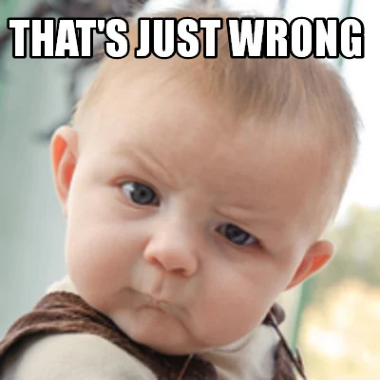
Demo
Sales Engineers version of only fans
They are trying to show you their best bits
How to get the most out of this
Have your pain points and goals clearly explained and documented
Interrupting is good if you actually have a question
Playing stump the chump is D bag behavior
SEs dont know everything but they should know who to ask
You really need to know your tech stack and infrastructure (many dont)
Look for BS and marketing stuff. Ask how things work / architecture
A lot of things can be faked here.
Build a scorecard for your goals so you don't get dazzled by a good demo

Slide 18
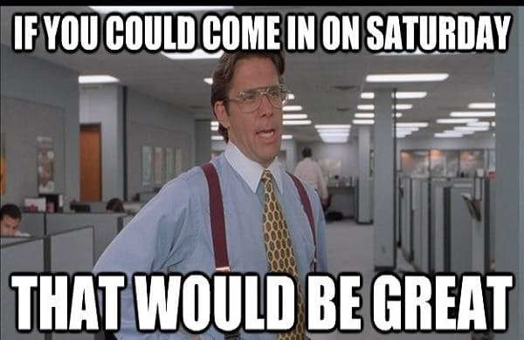

Proof of Value
This is a massive amount of work for both sides but especially the sales side. They have to account for the man hours lost if they dont get a technical win. Another reason why failing early is so important.
Be ready!!
Get stakeholders for tools ready
Have a scoring system
Make sure you have the man hours
Look out for BS from companies
Make a shared doc
Success criteria
Timeline
Scope
All tech info needed
Spend real time with the tools
Build relationships with SE
Make your team use the scoring system and notes

Slide 19

Executive Wrap ups and Procurement
Exec wrap is usually a what we did and how we benefit your company.
Sometimes there will be a BVA with this which is helpful on your end if it isnt pure bull shit.
Use this to show your boss you are busting your ass. Sales will try and make you look good.
Let procurement do their job but it shouldn't take a month to redline some paperwork. You have to protect yourself and do good business.
Good communication from the start will pay dividends here.
Sumo Logic

Slide 20
Just Yell at marketing people…..

Slide 21
Pitfalls and Traps
Keeping the competition Secret
after NDA not being open with tech
Not knowing your environment
no scoring system
not having budget
going strictly by price
trusting the easy button
Not introducing sales to the right person
liars
POV environments that aren't real
Not having clear answers and using marketing terms
Trying to sell things outside of your pain points and use cases
Marketing bullshit especially AI
Shady hidden costs
Not being transparent

Slide 22
Partners and resellers
Find one that you trust and enjoy
They don't need to know everything but do need to understand your goals and how to articulate them
They should already have relationships with companies that sell tools relevant to you but also willing to look at new tech
They make money by adding a percentage to the price BUT they usually get a percentage taken off for bringing the deal to the table (so it evens out)
They also get Spiffs from product companies
Find someone truthful and transparent

Slide 23
Top Annoying shit that needs to stop
Engineers: Turn on your fucking camera on a call!!!!!!
Sales People: Learn a little something and stop being king dbag
CISO: I know you aren't that busy stop acting special
SE: You are not the smartest person so stop trying to be
SDR: You call the wrong person at dinner….I will punch you
Marketing: This is a computer not an AI revolutionary cyber machine
RD: You where good at sales stop sucking at leadership
Procurement: You aren't a robot you can be nice and firm
Lawyers: I hate you
None of these are my viewpoints post next round of layoffs……

Slide 24
Compensation
OTE = on target earnings
SBRs
Small salary sometimes
Paid by qualified lead to meeting
Good ones are targeted and OSINT
SEs
around 70/30 OTE
Judged on technical wins
Makes a much smaller percent over OTE than the AE
AEs
40/60 OTE
Large percentage over OTE but sometimes capped
Has to start over every year with numbers higher than previous
Sumo Logic

Slide 25
Pricing
SAAS tools vary wildly on pricing
Bigger you are the bigger discount
70-85% sometimes for special accounts
If you aren't a multi 7 figure deal you can’t get that pricing no matter how good you negotiate
ProServe is sometimes treated as a separate company even when it's the same
Pricing abstract things is a bit of an art since every company is different
If you are just doing a pricing exercise to haggle with your current solution tell the sales people. Usually they will give that and it won't waste everyone's time
Sumo Logic

Slide 26
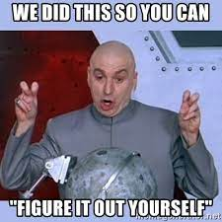
Services
You need to be realistic with how fast your team works and how organized your environment is.
A good pro-serve will try and estimate number of hours for YOUR goals.
Don't let them just throw a number at you. Dig into it.
First figure out what your team can do so you can give them a list to base hours and pricing off of. That will protect you from “packages”
Add a clause for buying extra hours at the same rate
Try and have adjustable hours to fit your schedule
Have a meeting with the engineers you will be working with
Meet their lead as well
1k+ hours they need to be cool people
Sumo Logic

Slide 27
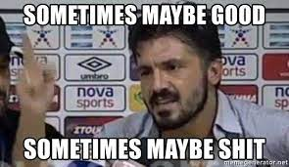
What worked for me?
A mix of self deprecating humor and integrity
I try and be open when I don’t know something, I work in a deep part of security.
I try to actually be a human and not a sales robot.
I abide in value selling and being a solutions architect.
I will and have told people when its not a good fit.
I try and remember how hard it is to look at multiple tools
I keep mutual goals of ours and customers in balance
Sumo Logic

Slide 28
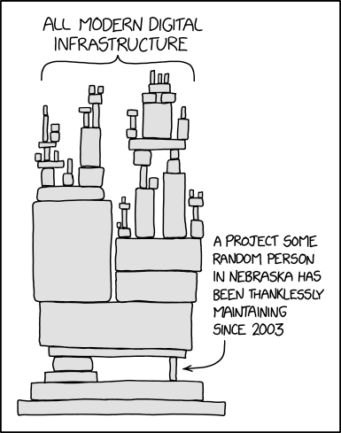
No Budget No Toys!
How do we get budget for a program?
Sometimes you can’t. It’s you and the open source tools you implement.
You can slowly show value.
Don’t jam up engineering.
Plan everything out and implement controls slowly and efficiently
Keep metrics on your findings and remediation.
Build those bridges!
Now with some value, learn to communicate to a business based audience. If you can show executives why financially it is good for the company, you will get closer to a real budget.
Being able to communicate effectively with the C-suite and board what an exploit can cost the company is as important as talking to engineers.
Old Slide
Sumo Logic

Slide 29
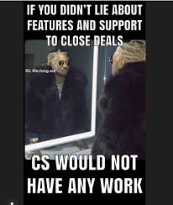
Liars, Snakes and Marketing teams
Look out for Bullshitters
Ask a ton of questions
Sometimes they aren't lying but just believe what marketing made up in their fantasy bullshit land
A lot of marketing people have their masters and no practitioner experience so there is a big gap
Slimy sales people suck but they don't tend to last that long at good places (It's a relationship game and a small pond)
Now dickheads on the other hand seem to stick around and keep selling…..avoid them
People make mistakes and do crazy shit when they need to make that mortgage payment. (RDs hire people with big payments on houses and cars)

Slide 30
Questions?
Warning: Answers may be opinion or flat out false. It is your fault for trusting a hacker.
Sumo Logic

